Slide 1
Kulugh Victor Emmanuel Department of Computer Science, Bingham University, Karu, Nigeria
200 Level- BSc. Cybersecurity
CYB 202 - Systems and Network Administration

Slide 2
Part A: Systems Administration – Definitions
A Systems Administrator (SA) - is an experts who ensures that all software and hardware systems functions properly to achieve organisation’s goals. SAs deal with physical computer servers, other hardware and software infrastructure. They provide support to users that need to access IT resources within the organisation’s ICT infrastructure. The Specific Duties of a System Administrator are outlined thus:

Slide 3
Systems Administration – Duties
User Accounts Management: User IDs, emails, group membership, permissions and restrictions, communicating policies and procedures, disabling/removing users
Hardware Management: Capacity planning, inventory, hardware evaluation and purchase, device driver installation, systems configurations and settings, user notifications and documentation.
Data Backups: Disk and backup media planning, disaster recovery (onsite/offsite, periodic testing, multiple copies, user communications/assurance (restore guarantees and procedures, loss tolerance).
Software Installation/Maintenance: Evaluation of software, download and building, installation, maintenance of multiple versions, security, patches and updates, user notification and documentation
System Monitoring: hardware and services, capacity (RAM, Disk, CPU, network), security (passwords, break-ins), systems logs.
Troubleshooting: problem discovery, diagnosis and resolution.
Local documentation: administrative policies and procedures (backup media locations, hardware description, configuration, connections and location, software – install location/media, installation and configuration details, patches and update installed); Acceptable use policies
Security concerns: systems login and audit, unexpected/unauthorised use detection, monitoring of security advisories.
User assistance: help desks, trouble-ticket systems, systems (hardware/software availability), etc.

Slide 4
Network Administration – definition
Network administrators (NA) is an ICT expert who’s role is to build computer networks and ensure continuous connectivity and availability of the networks. An NA focuses on setting up network equipment and ensuring that their network infrastructure can support user activities within the organisation. They also monitor overall activity and demands on the network, identify vulnerabilities, threats and strange traffic on the network.

Slide 5
Network Administration – Duties
i. Network design – planning the implementation of the network infrastructure.
ii. Research and select and order network hardware – E.g network cables, routers, switches, etc based on requirements with respect to the design
iii. Configuring/installing and testing network equipment – Linking the physical network devices and logically connecting them to be able to communicate.
iv. Troubleshooting and Maintenance of network infrastructure- diagnosing problems, establishing the root cause(s) and resolving them.
v. Monitoring Network activities – Observing user activities and network loads to proactively identify and resolve potential problems that may result
Setting up firewalls – set up fire walls to secure the network from unauthorised traffic and users.
vii. Respond to and fix network outages- when users report network downtimes, NAs ensure resolution.

Slide 6
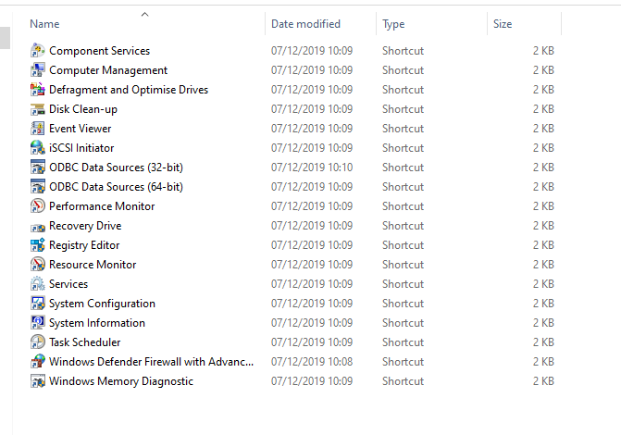
System Administration Tools
For systems administrators to perform their functions, they require a set of tools built into the operating system upon which their system run. E.g, Linux/Unix, windows, etc. Here we review some administrative tools for windows.
Assignment
Access the windows administrative tools for your version of windows from the control panel and explain the application of each of these tools.
To be submitted via email
gwaza.kulugh@gmail.com
Submission is on Monday, 23rd May, 2022

Slide 7
Disk Management and File Types
Disk Management is one of the advanced utilities in different versions of windows that enables SAs to perform different storage management task. The disk management utility can be accessed from the control panel or at the command prompt via the diskmgt.msc command.
Initializing new drive – activates a newly inserted disk that the system did not automatically recognise. Disk initialisation erases previously stored data on disk.
Extend a basic volume – extending empty space on the drive that do not have previous volume.
Shrink a basic volume -
Change drive label (letter) – provide labels for
Partition drive
Format drive
Mirror drive – creating redundancy that enables the content a drive automatically copied on another
Defragment drive – Opitimize drive by removing empty spaces between file and pushing them to the end.
Create storage pool – combining several drives on a system into a single space to form a storage pool.

Slide 8
Part B: Network Administration – Definitions
Network
A network is a connection of two or more computing devices through a media.
internetwork: Is the interconnection of two or more networks to form a bigger network.

Slide 9
Benefits of a Computer Network:
Cost-effective resource sharing.
Improving storage efficiency and volume.
Access flexibility.
Cut costs on software.
Utilize a Centralized Database.
Securing valuable information.

Slide 10
Types of Networks – cont’d
Types of Computer Networks
LAN
WAN
MAN
CAN
SAN
Local Area Network
Metropolitan Area Network
Wide Area Network
Storage Area Network
Campus Area Network

Slide 11
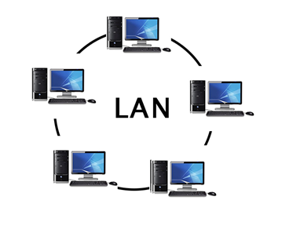
Types of Networks – LAN
LAN is a group of computers connected to each other in a small area such as building or an office. Communication in LAN is through medium such as twisted pair, coaxial cable, etc. it is built with inexpensive hardware such as hubs, network adapters, and ethernet cables. Data transferred rate is extremely fast in LAN and provides higher security.
Local Area Network

Slide 12
Types of Networks – CAN
CAN is a network that spans a limited geographic area, usually;
bigger than a LAN but smaller than the WAN and MAN.
CANs interconnect multiple LANs within an educational or corporate campus.
Unlike LANs, most CANs connect to the public Internet.
Typically, the organization that owns the campus also owns and operates all the networking equipment and infrastructure for the CAN.
In contrast, MANs and WANs may combine infrastructure operated by several different providers.

Slide 13
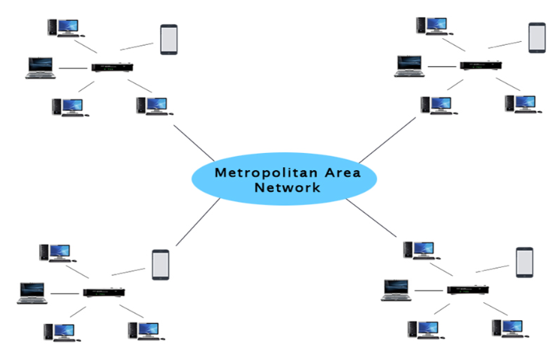
Types of Networks – MAN
LAN -1
MAN is a network that covers a larger geographic area, like an entire city or metropolis. It is formed by connecting several LANs through telecommunication infrastructure (telephone exchange line). Data transmission rate is not as fast as in LAN and is less secured compared to LAN
LAN -4
LAN -2
LAN -3

Slide 14
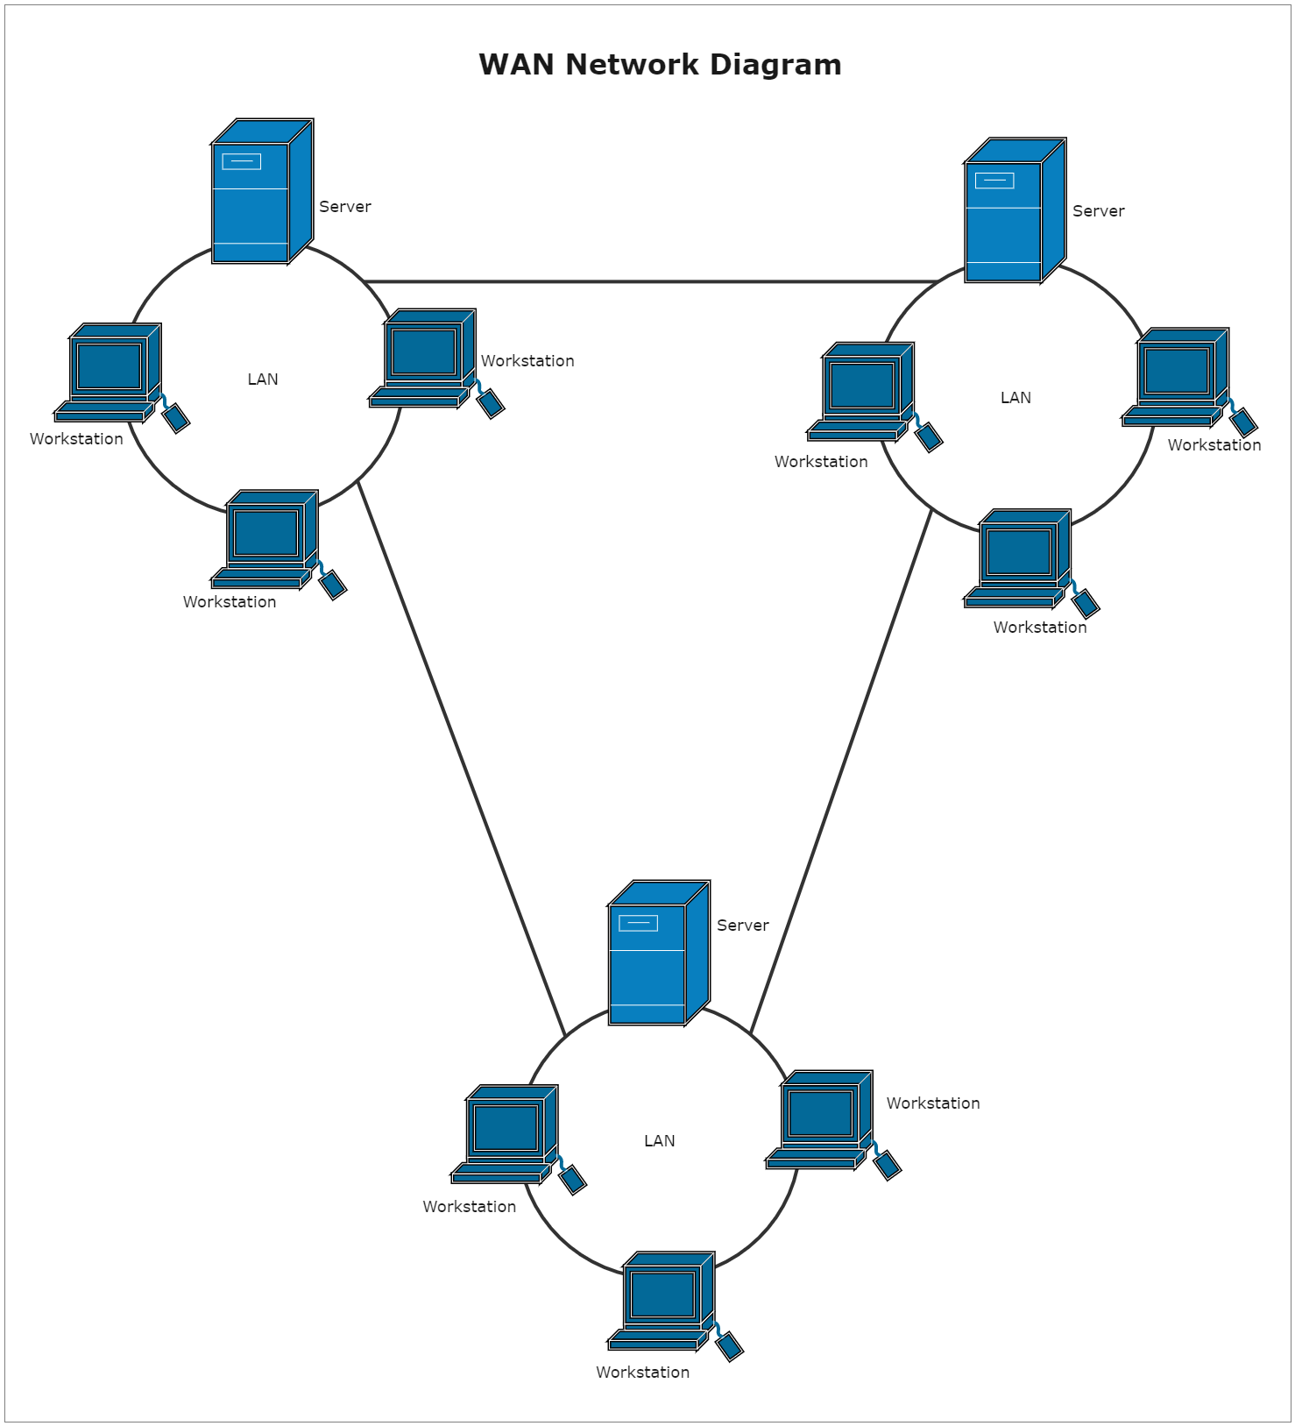
Types of Networks – WAN
WAN is a network that extends over a large geographical area such as across cities, states or countries. It is bigger than LAN and MAN and involves the connection of several LANs/MANs via telephone line, fibre optic cable or satellite links, etc. WAN is used in business, government, education, etc.
The internet is one of the biggest WAN in the world.
wide area network

Slide 15
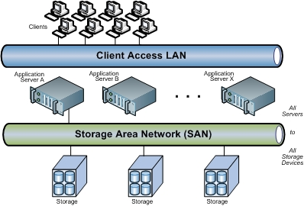
Types of Networks – SAN
SAN is a specialized, high-speed network that provides network access to storage devices. They composed of hosts, switches, storage elements, and storage devices that are interconnected using a variety of technologies, topologies, and protocols.
SAN presents storage devices to a host in a manner that the storage appears to reside on the host.

Slide 16
Network Topologies
Network Topologies
BUS
Tree
Daisy Chain
Ring
Hybrid
Star
Mesh
Point-to-point

Slide 17

Network Topology – point-to-point
Point-to-point networks contains exactly two hosts such as computer, switches or routers, servers connected back to back using a single piece of cable. Often, the receiving end of one host is connected to sending end of the other and vice-versa.
If the hosts are connected point-to-point logically, they may have multiple intermediate devices. But the end hosts are unaware of underlying network and see each other as if they are connected directly.

Slide 18
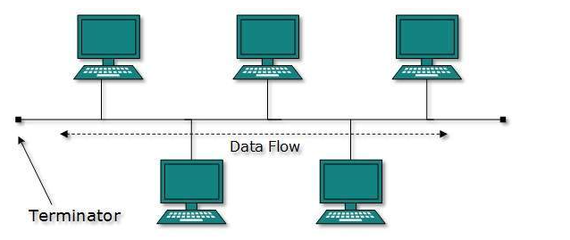
Network Topology – Bus
All connected nodes share single communication line.
There is problem of collision when multiple hosts send data at the same time.
To resolve this problem, Bus topology uses:
CSMA/CD technology,
or recognizes one host as Bus Master.
Failure of one node does not affect the other devices.
However, failure of the shared communication line can disrupt the entire network

Slide 19
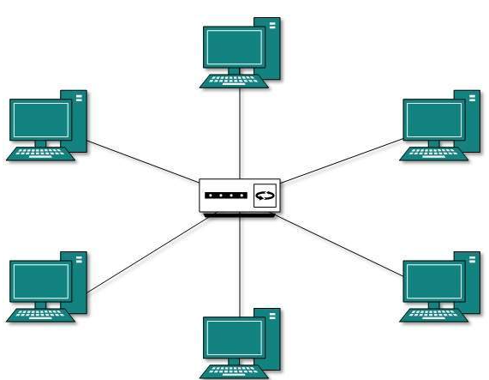
Network Topology – star
All hosts in Star topology are connected to a central device. The hub device can be any of the following: hub or repeater; switch or bridge; router or gateway
As in Bus topology, hub acts as single point of failure. If hub fails, connectivity of all hosts to all other hosts fails.
Communication between hosts takes place through only the hub.
Star topology is inexpensive, to connect one more host, only one cable is required and configuration is simple.

Slide 20
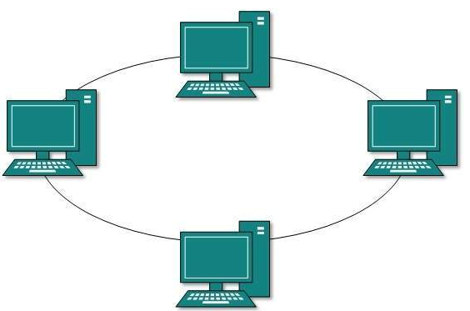
Network Topology – Ring
In ring topology, each node connects to exactly two other nodes, creating a circular network structure.
When one host tries to communicate or send message to a host which is not adjacent to it, the data travels through all intermediate hosts. To connect one more host in the existing structure, the administrator may need only one more extra cable.
Failure of any host results in failure of the whole ring. Thus, every connection in the ring is a point of failure. To resolve this point of failure issue, one more backup ring is used

Slide 21
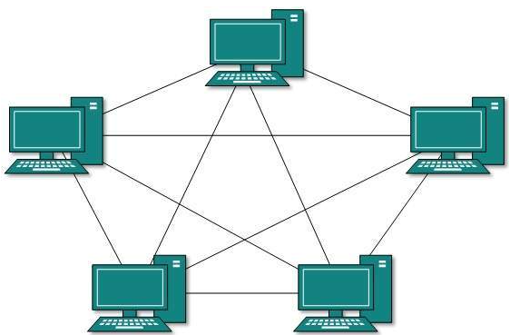
Network Topology – Mesh
This supports the connection one node to one or multiple hosts. This topology has hosts in point-to-point connection with every
other host may also have hosts which are in point-to-point connection to few hosts only. It comes in two variants:
Full Mesh: All hosts have a point-to-point connection to every other host in the network. It provides the most reliable network structure among all network topologies.
Partially Mesh: Not all hosts have point-to-point connection to every other host. Hosts connect to each other in some arbitrarily fashion. This topology exists where we need to provide reliability to some hosts out of all.

Slide 22
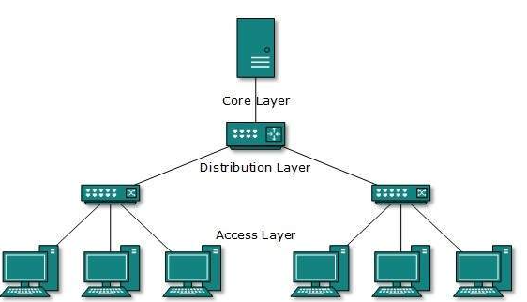
Network Topology – Tree or Hierarchical
This is built as an extended Star topology and inherits some properties of bus topology. It supports the division of a network into multiple layers. Mainly in LANs, a network is bifurcated into three types of network devices. The lowermost is access-layer where computers are attached. The middle layer is known as distribution layer, which works as mediator between upper layer and lower layer. The highest layer is known as core layer, and is central point of the network, i.e. root of the tree from which all nodes fork.

Slide 23

Network Topology – Daisy Chain
The daisy chain connects nodes in a linear pattern. Similar to Ring topology, each host is connected to two hosts only, except the end hosts. Means, if the end hosts in daisy chain are connected then it forms a Ring topology.
Each link in daisy chain represents single point of failure. Every link failure splits the network into two segments. Every intermediate host works as relay for its immediate hosts.

Slide 24
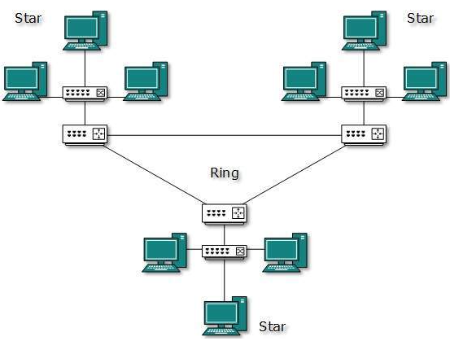
Network Topology – hybrid
A combination of multiple network topologies to build a single network. It inherits the advantages and disadvantages of the various topologies forming the hybrid topology network. WANs, MANs and the Internet are built on this model.

Slide 25
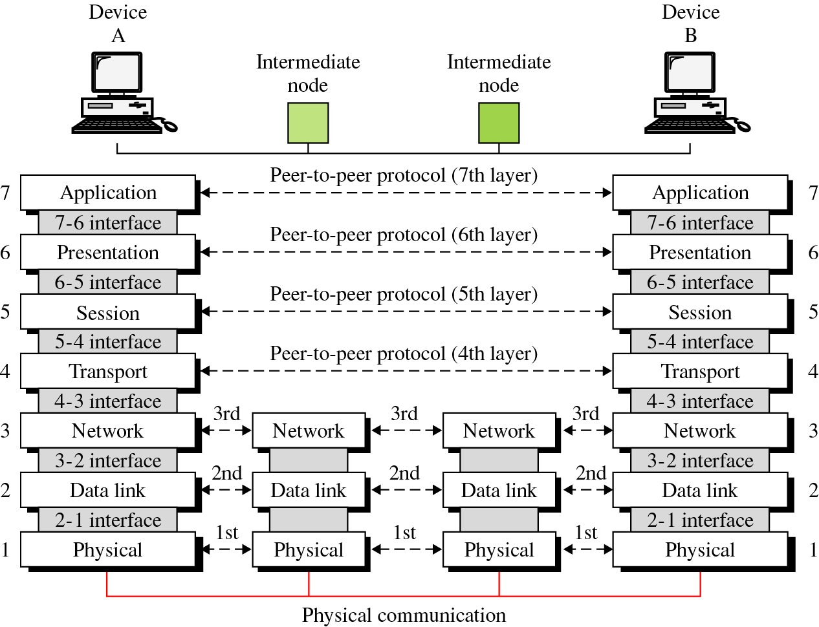
Open System Interconnection (OSI) Reference Model
The OSI reference model was created by the International organisation for standardization for the following purposes:
standardize data networking protocols to allow communication between all networking devices
Provides a model for software/hardware vendors to create products that can interoperate on the networks. E.g. IBM products communicate with CISCO equipment
Help network administrators determine easily the hardware/software requirements for building a network.
Provide a teaching/learning tool that enables the understanding of the communication process used between networking components
Makes troubleshooting easier for network administrators
Application - Physical - All People Seem To Need Data Processing
Physical – Application - Please Do Not Throw Sausage Pizza Away

Slide 26
Open System Interconnection (OSI) Reference Model
# | Layer | Function | Data units | Hardware | Protocols
7 | Application | Provides network interface for application | Message/Data | Gateway | DHCP, HTTP, HTTPS, FTP, telnet, SMTP, SNMTP, etc.
6 | Presentation | Translates data format to ensure that applications layer data of one system can be identified and understood by the application later data of another system. | Message/Data | Gateway, redirector | TLS, SSL, AFP
5 | Session | Establishes, manages and terminates sessions between communicating parties | Message/Data | Gateway | NetBIOS, RPC, SMB, socks
4 | transport | Establishes, maintains and cancels end-to-end data transmission process. Controls transmission speed and adjust data sequences. | TCP segment; UDP segment | Gateway | TCP, UDP, SCTP
3 | Network | Defines logical addresses and transfers data from source to destinations. | Packet/ Datagram | Router, Brouter | IP, IPSec, ARP, NAT, ICMP, ICMP(ping)
2 | Data link | Encapsulates packets into frames, transmits frames in point-to-point or point-to-multipoint mode and implements error detection | Frames, Cells | Switch, Bridge, NIC | MAC, ARP, ethernet, VLAN, L2TP
1 | Physical | Transmits bitstreams over transmission media and defines electrical and physical specifications | Bit, Frame | Cables, modems, hubs, repeaters, NIC, multiplexers | Ethernet, IEEE802.11, ISDN, USB, Bluetooth

Slide 27
Mapping of TCP/IP Model and the OSI Model
OSI | TCP/IP
Application Layer | Application Layer TELNET, FTP, SMTP, TFTP, POP3, SNMP, DNS, HTTP, etc.
Presentation Layer
Session Layer
Transport Layer | Transport Layer TCP , UDP
Network Layer | Internet Layer IP , ICMP, ARP, RARP, IGMP
Data Link Layer | Link Layer FDDI, Ethernet, ISDN, X.25, PPPoE
Physical Layer

Slide 28
TCP/IP Protocols – Application Layer Protocols – HTTPS
HTTP (HyperText Transfer Protocol) is the foundation of data communication on the World Wide Web.
Protocol: HTTP is a protocol used for transmitting hypermedia documents, such as HTML.
Stateless: Each HTTP request from a client to server is independent; the server does not retain any state information about the client after the request is completed.
HTTP
Client
Internet
HTTP Server
.COM
www.binghamuni.edu.ng
HTML files of the page are returned

Slide 29
TCP/IP Protocols – Application Layer Protocols - HTTPS
HTTPS (HyperText Transfer Protocol secure): Provides Secure HTTP channel.
The Transport Layer Security (TLS) protocol is added to HTTPS based on HTTP to enable:
identify authentication,
data encryption and integrity verification,
HTTPS uses port number 443 and HTTP uses port number 80
.COM
.COM
Plain text communication
Cyber-text communication
HTTP Client
HTTP Server
HTTP Client
HTTP Server
HTTP
HTTP
TCP
TLS
Identity authentication
Data encryption
Integrity verification
IP
TCP
IP

Slide 30
TCP/IP Protocols – Application Layer Protocols - DNS
The Domain Name server (DNS) maps human readable domains or website addresses unto machine readable IP addresses and maintains a database of this mapping.
A Domain Name Server (DNS) translates human-readable domain names (like www.example.com) into machine-readable IP addresses (like 192.168.1.1).
This system allows users to access websites using easy-to-remember names instead of numerical IP addresses, facilitating easier navigation and connectivity on the internet.
DNS is classified into static and dynamic domain name resolution. Static domain name is first used to resolve a domain name, if the resolution fails, dynamic domain name is applied.

Slide 31
TCP/IP Protocols – Application Layer Protocols - DNS
Client
Local DNS server
Internet
Send a request for the address of www.binghamuni.edu.ng
Returned the IP address xx.xxx.x.x
Access internet xx.xxx.x.x

Slide 32
TCP/IP Protocols – Application Layer Protocols - FTP
File Transfer Protocol (FTP) is a standard network protocol used to transfer files between a client and a server on a computer network.
FTP operates over TCP/IP and typically uses port 21 for control commands and port 20 for data transfer.
It allows users to upload, download, and manage files on remote servers, supporting operations such as creating directories, deleting files, and changing permissions.
FTP can operate in active or passive modes to accommodate different network configurations. The difference between the two is whether data connection is initiated by server or client.
FTP is inherently insecure, leading to the development of secure alternatives like FTPS (FTP Secure) and SFTP (SSH File Transfer Protocol).
FTP is a dual channel protocol with control and data channel.

Slide 33
TCP/IP Protocols – Application Layer Protocols - FTP
Passive mode is when the client initiates both the control and data connections. In this mode, the client sends a PASV command to the server. The server then responds with an IP address and port number for the client to use to establish the data connection. Passive mode is typically used to handle issues with firewalls and NAT (Network Address Translation) that block incoming connections. By allowing the client to initiate both connections, passive mode facilitates smoother file transfers in restricted network environments.
proactive mode is when the client initiates the control connection, but the server initiates the data connection. In this mode, the client sends the server the PORT command, which includes the client's IP address and a port number that the client has opened for the data connection. The server then uses this information to establish the data connection back to the client. Active mode can be problematic when the client is behind a firewall or NAT (Network Address Translation) because these often block incoming connections, making it difficult for the server to initiate the data connection.

Slide 34
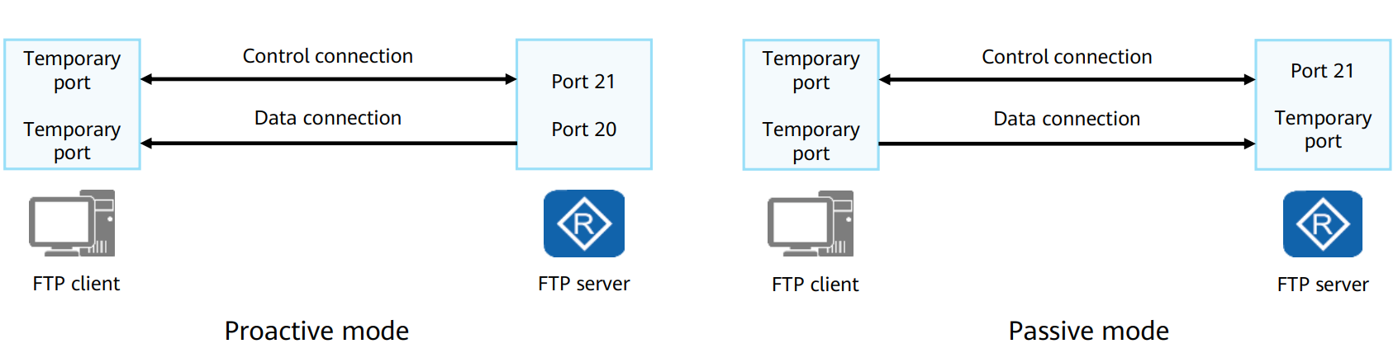
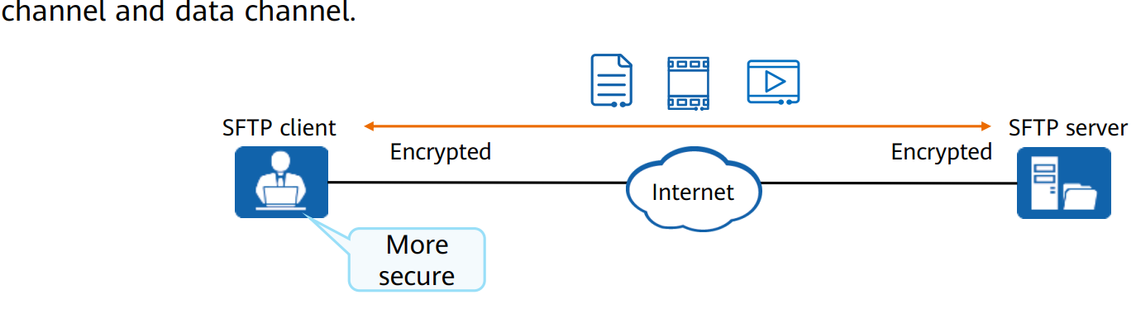
TCP/IP Protocols – Application Layer Protocols - SFTP
Secure file transfer protocol (SFTP) transfer files securely based on the secure shell SSH
SFTP encrypts the authentication information and data to be transmitted. With higher security compared to FTP.
SFTP is a single channel protocol and its default destination port is 22
The client and server are securely connected using SSH to securely transfer files.
FTP
SFTP

Slide 35
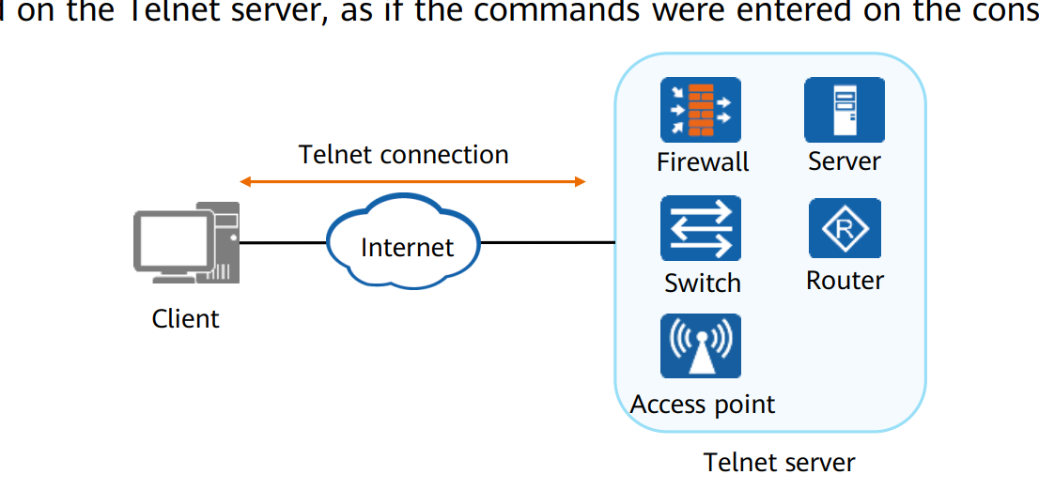
TCP/IP Protocols – Application Layer Protocols - TELNET
Telnet is a network protocol used to provide a command-line interface for communication with remote devices over a TCP/IP network
It allows users to remotely access and manage devices such as servers, routers, and switches.
Telnet operates on port 23 by default and enables users to execute commands as if they were physically present at the device.
Despite its usefulness, Telnet transmits data, including passwords, in plaintext, making it highly

Slide 36
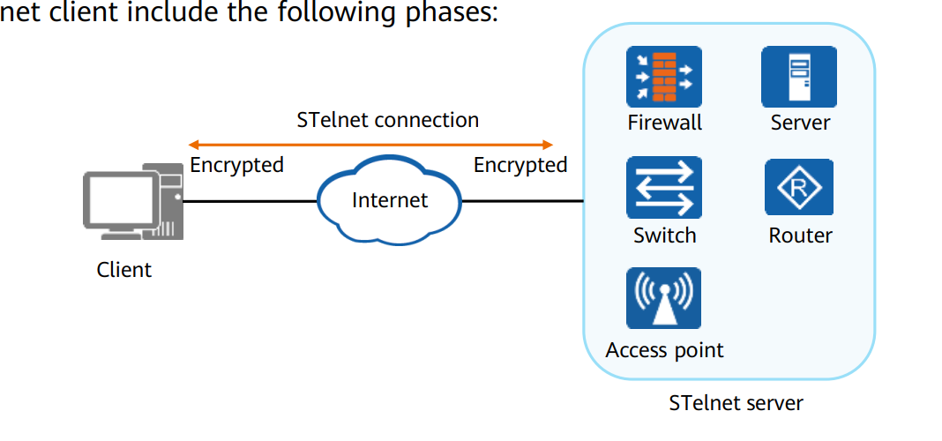
TCP/IP Protocols – Application Layer Protocols - STELNET
Stelnet secured telnet implemented based on SSH with port number 22. negotiation between an Stelnet server and Stelnet client involves the following stages:
Version negotiation – server and client negotiates which version of SSH to use (SSHv1 or SSHv2).
Algorithm negotiation – The server and client negotiate the encryption algorithm to be used from the multiple algorithms supported by SSH.
Key exchange – session key is generated using key exchange algorithms, the session is used to encrypt the session between the client and server.
User authentication – the SSH client sends an authentication request to the server and the server authenticates client.
Session interaction – after a successful authentication, the server and client exchange data.

Slide 37
Internet Protocol (IP) Addressing
An IP address uniquely identifies each device on an IP network so that data can be sent correctly to those locations. For example: Address on a letter, Telephone number
Every host (computer, networking device, peripheral) must have a unique address.
Notes:
Lesson Aim
<Enter lesson aim here.>

Slide 38

Parts of the IP Address
Each IP address consists of:
Network ID
Identifies the network to which the host belongs
Assigned by registry authority and cannot be changed
Host ID
Identifies the individual host
Assigned by organizations to individual devices
Notes:
Lesson Aim
<Enter lesson aim here.>

Slide 39
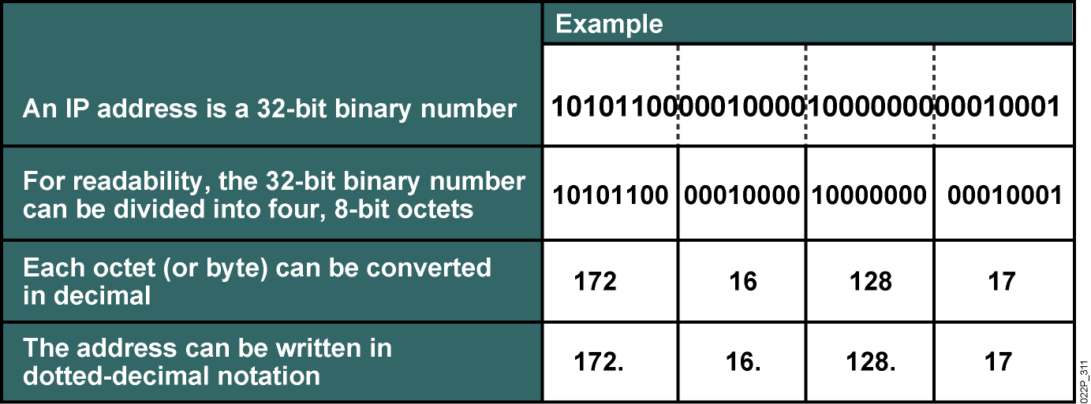
IP Address Format: Dotted Decimal Notation
32 bits, with 8 bit groupings
Example 172.16.128.17
Each number between the dots can be between 0 and 255
Allocated in groups called address blocks
3 sizes, based on the class of the address
Class A, Class B, and Class C
Notes:
Lesson Aim
<Enter lesson aim here.>

Slide 40
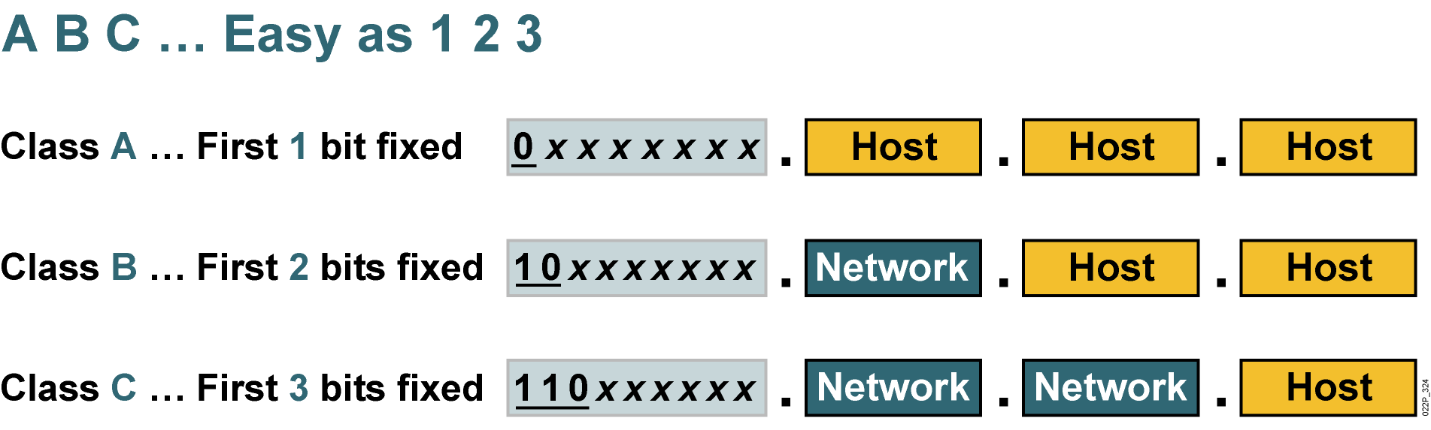
IP Address Classes: The First Octet
Notes:
Lesson Aim
<Enter lesson aim here.>

Slide 41
IP Addresses Classes cont’d
Class A:
Owned giant organizations like ISPs, Large Internet companies like Google, CNN, etc
All IP addresses are of the form:
0 – 126.x.x.x
x can be between 0 and 255
The first octet is assigned to the owner, the remaining 3 are freely distributable to the nodes. Thus, It Has a 24 bit address space
Uses up to half of the total IP addresses available
Class B:
All Class B Addresses are of the form:
128 - 191.x.x.x
Where x can take any number between 0 and 255
The first two octets are assigned to the address block owner, with the last two freely distributable
Has 16-bit address space
¼ of all IP addresses belong to Class B Addresses

Slide 42
IP Addresses Classes cont’d
Class C:
All Class C Addresses have the following format:
192-223.x.x.x
The first three octets are assigned, with the last being freely distributable
Only 253 distributable addresses within a Class C Address
Class D:
Multicast addresses
224 – 247.x.x.x
Class E:
248 – 255.x.x.x
Experimental purposes

Slide 43
IP Address Ranges
Class | Range | Number of Possible Networks | Number of Possible Hosts in One Network | Number of Usable Hosts in One Network
A | 1-126 | 126 | 16,777,216 | 16,777,214
B | 128 -191 | 16,382 | 65,536 | 65,534
C | 192-223 | 2,097,150 | 256 | 254
*127 (011111111) is a Class A address reserved for loopback testing and cannot be assigned to a network.
Number of Possible networks is = 2^{x-y,} Where x = number of network bits and y = number of fix bits in the network bits. Note that y depends on the IP address Class
Number of Possible Hosts in one network = 2^{x} where x is the number of hosts bits
Number of usable hosts in one network is = 2^{x} – 2, where x is the number of host bits

Slide 44
Reserved IP Addresses
Private Networks (no public connections)
10.x.x.x – Class A
172.16.x.x – Class B
192.168.x.x – Class C
Local Network
127.x.x.x – local network (loopback)
Multicast
255.255.255.255 – broadcast – sends to everyone on the network

Slide 45
IP Address Shortage
IPv4 has potential for 4 billion IP addresses, However, with increased Internet Connectivity, this number is running out.
Applications increasing Demand
Applications in IoTs
Mobile devices
It is projected that by the year 2030, there will be tens of billions of connections
A solution has been created through the 128 bits IPv6 but majority of Internet users are yet to adopt IPv6 due to compatibility issues between IPv4 and IPv6
Thus, leading to shortage in IPv4 addresses and increase in their cost/IP

Slide 46
IP Address Shortage – Solution
Network Address Translation (NAT) - Hides many nodes behind limited set of public addresses
Block of addresses are located to ISPs and organisations
This is based on classes of IP addresses
What if we have a class C allocation that allows for 254 IPs and we have 500 computing devices to connect?
Use a gateway/router to map invalid (reserved) addresses to valid IP addresses
Translates your local address to a routable address
Router receives one IP Address
Either dynamically assigns addresses to all the nodes behind the router, or it is assigned statically using non-routable addresses
If dynamic, uses DHCP (Dynamic Host Configuration Protocol)
When someone inside the network wants to access a computer outside the local network (the internet), the request is sent to the router, which uses NAT to send the request to the internet.
NB: This has potentials to increase security as these IPs are not visible outside the network

Slide 47
IPv4 and IPv6
IPv6 was developed by the Internet Engineering Task Force (IETF) to provide a long term solution to the problem of IP exhaustion in IPv4.
It is 128-bits IP addressing Scheme and has address space of 2¹²⁸ bigger than IPv4 with 2³²
340,282,366,920,938,463,463,374,607,431,768,211,456 Ips
340 undecillion, approximately 3.4×10³⁸
There are 8 groups separated by colon, each group is represented by 2 bytes (16bits) written in hexadecimal form

Slide 48
IPv4 and IPv6 – cont’d
An IPv6 address is 128 bits in length and consists of eight, 16-bit fields, with each field bounded (separated) by a colon. Each field must contain a hexadecimal number, in contrast to the dotted-decimal notation of IPv4 addresses. In the next figure, the x's represent hexadecimal numbers.
2001:0DB8:3C4D:0015:0000:0000:1A2F:1A2B
Most IPv6 addresses do not occupy all of their possible 128 bits. This condition results in fields that are padded with zeros or contain only zeros
X:X:X:X:X:X:X:X, Note that each X represents a 16-bits field unlike the 4-8bits field in IPv4

Slide 49
IPv4 and IPv6 – Abbreviating IPv6 addresses
Most IPv6 addresses do not occupy all of their possible 128 bits. This condition results in fields that are padded with zeros or contain only zeros
The IPv6 addressing architecture allows one to use the two-colon (::) notation to represent contiguous 16-bit fields of zeros. For example, you might abbreviate the IPv6 address:
2001:0DB8:3C4D:0015:0000:0000:1A2F:1A2B to:
2001:0DB8:3C4D:0015::1A2F:1A2B leading zeros in the fields can also be removed. For example: 0DB8 can become DB8 and 0015 can become 15, the new address becomes: 2001:DB8:3C4D:15::1A2F:1A2B

Slide 50
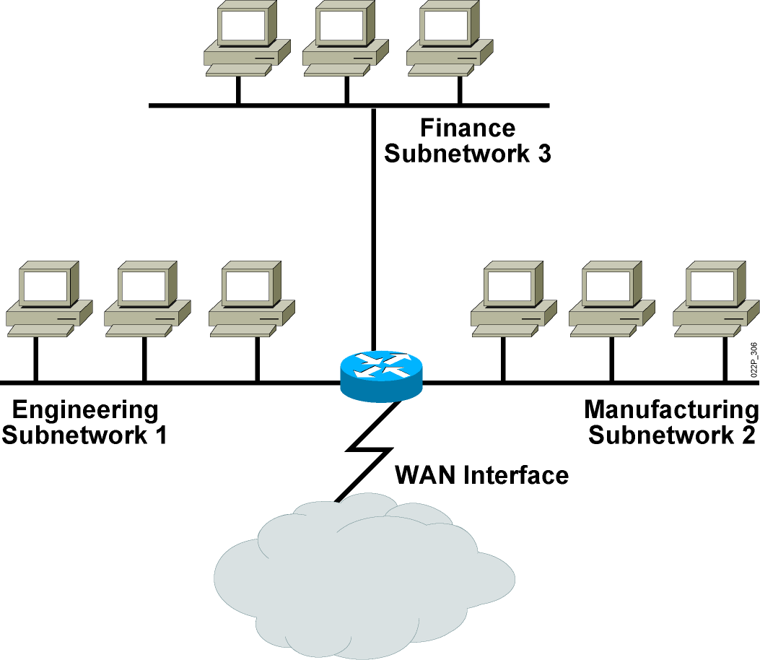
Subnetworks
Subnet – Logical division of IP networks into 2 or more networks
Purpose
Reduce network congestions
Improve network performance
Improve security
Routers are used to communicate between subnets. However, a subnet allows its linked devices to communicate with each other.
Notes:
Lesson Aim
<Enter lesson aim here.>

Slide 51
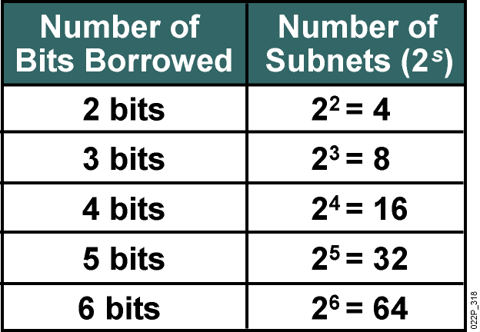
Number of Subnets Available
To determine the number of subnets:
Borrow bits from the host ID portion of the IP address
Number of subnets available depends on the number of bits borrowed.
One address is still reserved as the network address.
One address is still reserved as broadcast address.
Available number of subnets = 2^{s} where ‘s’ is the number of bits borrowed.
If we have a class C address, the number of possible subnets is as shown in the table.

Slide 52
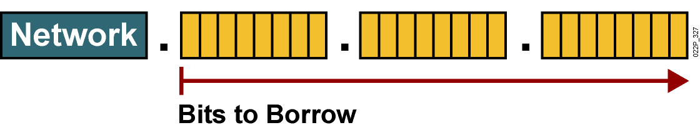
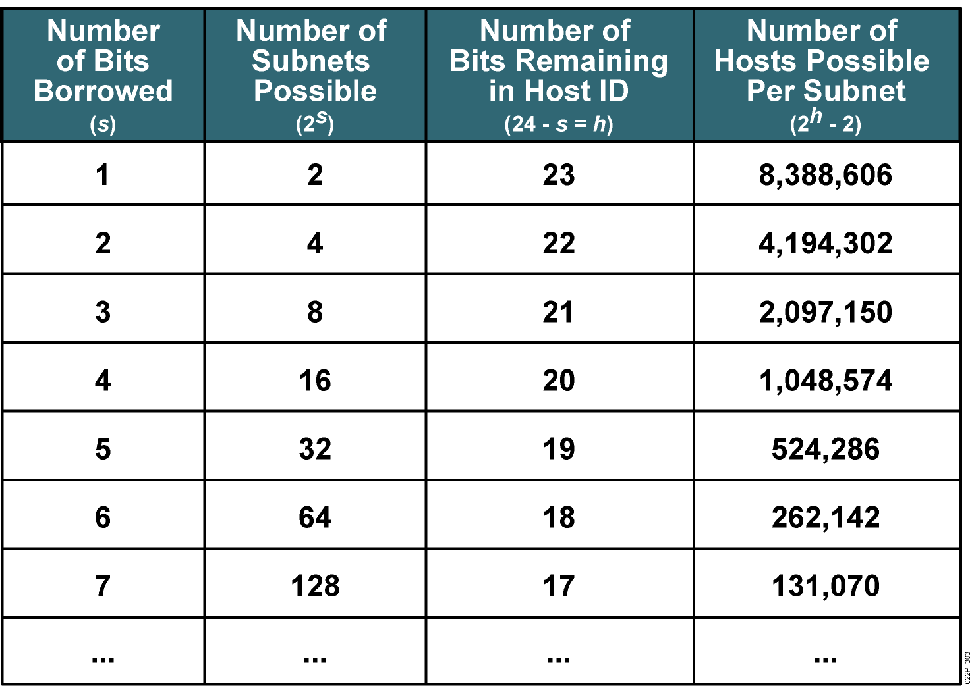
Possible Subnets and Hosts for a Class A Network

Slide 53
Building subnets from a network
You are required to create four networks for faculties of science and tech, agriculture, engineering and medicine with each faculty having 60 systems.
Since we need 60 systems per network, we require a class C IP address: 192.168.4.0
Network ID
subnet ID
Host ID
Although, we have discussed previously that an IP address has two IDs - network and host, as we want to create a subnet, a third ID is introduced between the network and host IDs – i.e subnet ID. The subnet ID is taken from the Host ID, that is, bits are borrowed from the host ID depending on the number of subnets that are to be created. For example we need 4 subnets, therefore, we borrow 2 bits from the host ID. the subnet IDs for the subnets based on borrowed bits will be: 00, 01, 10 and 11. Thus:
Our first network commences from 00000000-01000000 (0 – 63), 2nd subnet 0100000000-01111111 (64-127), 3rd network from 10000000 – 10111111(128-190) and 4th network from 11000000 – 11111111 (192-255)
Note that the number of bits borrowed is a function of the number of subnets required, for example, if we need 8 subnets, we will borrow 3 bits, if we need 16 subnets, we will borrow 4 bits, etc.

Slide 54
Building subnets from a network - Example
You are given a network 192.168.4.0/24 to create three networks for department of finance, engineering and manufacturing
Step 1: Create a Subnetting Table and identify the column that gives you the number of subnets
Subnet | 1 | 2 | 4 | 8 | 16 | 32 | 64 | 128 | 256
Host | 256 | 128 | 64 | 32 | 16 | 8 | 4 | 2 | 1
Subnet Mask | /24 | /25 | /26 | /27 | /28 | /29 | /30 | /31 | /32
Here, 4 represents the number of subnets, 64 is the number of possible host (host IDs) and /26 is the new subnet mask.

Slide 55
Building subnets from a network
Network ID | Host ID range | Number of Usable Host IDs | Broadcast ID
192.168.4.0 | 192.168.4.1 – 192.168.4.62 | 62 | 63
192.168.4.64 | 192.168.4.65 – 192.168.4.126 | 62 | 127
192.168.4.128 | 192.168.4.129 – 192.168.4.190 | 62 | 191
192.168.4.192 | 192.168.4.193 – 192.168.4.254 | 62 | 255

Slide 56
Building subnets from a network
First host ID is reserved for network ID and last host ID reserved for Broadcast ID
Network ID | Subnet Mask | Host ID range | Number of Usable Host IDs | Broadcast ID
192.168.4.0 | /26 | 192.168.4.1 – 192.168.4.62 | 62 | 63
192.168.4.64 | /26 | 192.168.4.65 – 192.168.4.126 | 62 | 127
192.168.4.128 | /26 | 192.168.4.129 – 192.168.4.190 | 62 | 191
192.168.4.192 | /26 | 192.168.4.193 – 192.168.4.254 | 62 | 255

Slide 57
Network Management – NIC and MAC Addresses
Network Interface (NI) is an interface to a network from a computer, server, printer or any device that connects to a network. All modern computing devices have network interfaces, either wired (ethernet cable) or wireless to connect to a wireless access point (WAP).
Traditionally, NI came on a separate card thus are referred as network interface cards (NIC). In recent times, NI are built-in on the motherboard

Slide 58
Uses of the NIC
Provides connection to the network media/Medium (ethernet cables, blue tooth, wi-fi, satellite, etc).
They have physical addresses referred to as the MAC address
Enable communication with other devices on the network
Takes data from the OS, Encapsulates it into frames and makes it suitable for transport on the network.

Slide 59
Differences Between MAC and IP Addresses
MAC addresses Identifies the device, IP addressed provides the location of the device on the network
MAC addresses are permanent identifiers of devices, a device IP address may change.
Example – IP addresses are like mailing addresses of people living in a house, MAC addresses are the actual names of the individuals living in the house.
All device manufacturers must contact IEEE to give them block of MAC addresses which they burn into the NIC cheap of all devices such that no two devices on earth would have the same MAC addresses

Slide 60
MAC Addresses
A MAC address also referred to as physical or hardware address is a 48-bits number coded in 12 hexadecimal numbers with each hex character representing 4 bits. The hex characters are grouped in twos separated by hyphen.
MAC Address
00-BB-BC
83-95-A2
Manufacturer’s ID
Device ID
The first 6 characters represent the device manufacture’s ID also referred to as Organisational Unique Identifier (OUI).
The second block of 6 digits is referred to as the device ID

Slide 61
Network zoning

Slide 62
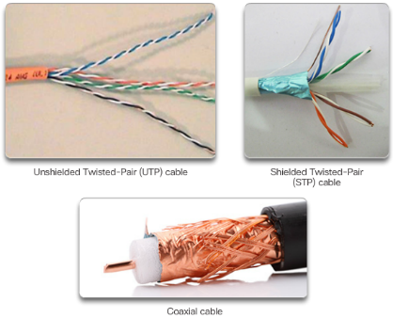
Network Media Copper Cabling
Characteristics of Copper Cabling
Inexpensive, easy to install, low resistance to electric current
Distance and signal interference
Copper Media
Unshielded Twisted-Pair Cable
Shielded Twisted-Pair Cable
Coaxial Cable
Copper Media Safety
Fire and electrical hazards
Notes:
4.2 – Network Media
4.2.1 – Copper Cabling

Slide 63
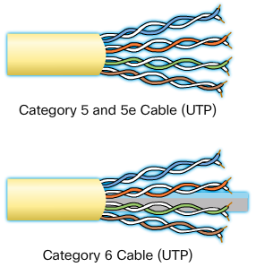

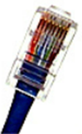
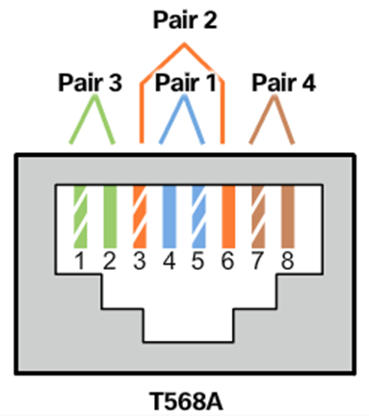
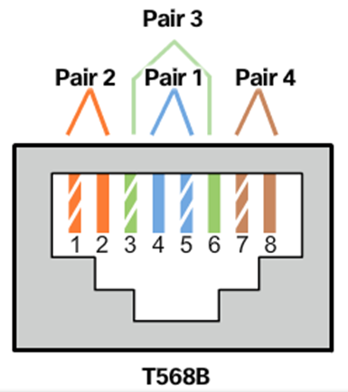
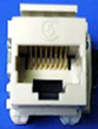
Network Media UTP Cabling
Properties of UTP Cabling
Cancellation of EMI and RFI signals with twisted pairs
UTP Cabling Standards
TIA/EIA-568
IEEE: Cat5, Cat5e, Cat6, Cat6e
UTP Connectors
Types of UTP Cable
Rollover
Crossover
Straight-through
Testing UTP Cables
Cable Pinouts
Notes:
4.2 – Network Media
4.2.2 – UTP Cabling

Slide 64
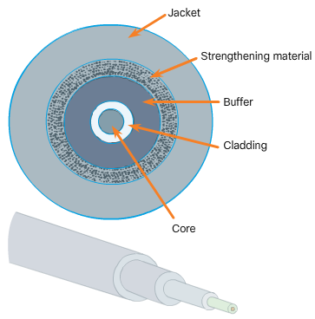
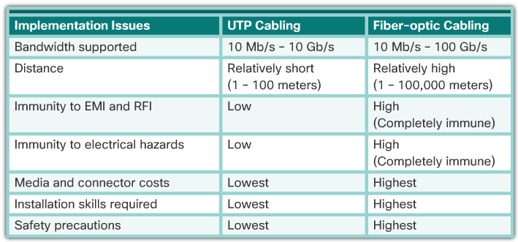
Network Media Fiber-Optic Cabling
Properties of Fiber-Optic Cabling
Transmits data over longer distances
Flexible, but thin strands of glass
Transmits with less attenuation
Immune to EMI and RFI
Fiber Media Cable Design
Types of Fiber Media
Single mode and multimode
Fiber-Optic Connectors
Testing Fiber Cables
Fiber versus Copper
Notes:
4.2 – Network Media
4.2.3 – Fiber-Optic Cabling

Slide 65
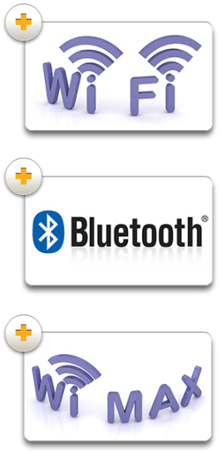
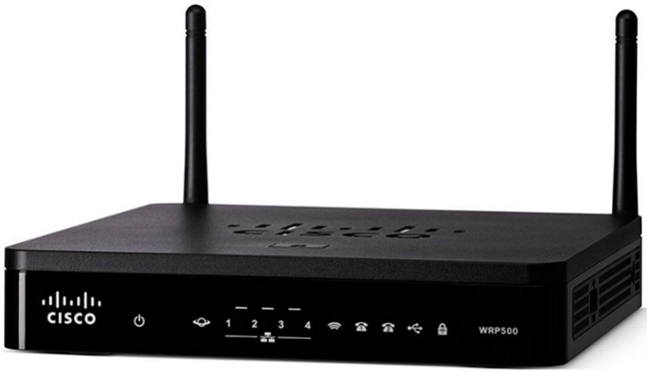
Network Media Wireless Media
Properties of Wireless Media
Data communications using radio or microwave frequencies
Types of Wireless Media
Wi-Fi, Bluetooth, WiMax
Wireless LAN
Wireless Access Point
Wireless NIC adapters
Notes:
4.2 – Network Media
4.2.4 – Wireless Media

Slide 66
Network Equipment- Hub and Switch
Hub
Connects network devices together on an internal network
it has multiple ports for ethernet connections from multiple network devices
Not intelligent because it does not have capability for filtering data or knowing where the data is to be sent
When a data packet arrives at one of its ports, it is rebroadcasted to all other devices whose ports are connected to the hub.
Disadvantages
(1) Unnecessarily traffic and (2) security issues
Switch
Connects network devices together on same network
Intelligent and capable of learning the MAC addresses of all devices connected to it
Stores MAC addresses in a table and send data packets only to a particular receiving device
Operates at data link layer
NB: Hubs and Switches only exchange data within an internal network as they do not have capabilities to read IP addresses

Slide 67
Network Equipment - Switch
Connects network devices together on same network
Intelligent and capable of learning the MAC addresses of all devices connected to it
Stores MAC addresses in a table and send data frames only to a particular receiving device
Operates at data link layer
NB: Hubs and Switches only exchange data within an internal network as they do not have capabilities to read IP addresses

Slide 68
Network Equipment – Router
Routes or forward data packets from one network to another based on IP addresses
Inspects a data packet and determine if it were meant for its own network or another
It receives it if it were meant for it but rejects it if its meant for another network
It’s a gateway for its network
Layer 3 device
Essentially, hub and switches are used to create networks while routers are used to connect networks

Slide 69
Routing and Routing Protocols
You are provided a network 192.168.4.0/24 to create 4 subnets for the departments of computer science, chemistry, biology, physics, with 60 nodes each.
State the number of bits you will borrow from the Host ID to create the required number of subnets.
Show the bits combinations that are possible from the number of bits borrowed in (a) above.
Using the information in (b) compute the range of values for each network (show your work)
Using a table, present the network ID, Host ID Range, Number of Usable Host IDs and Broadcast IDs for each of the networks as generated from (c).

